Slide 1
Kancelarijska oprema/uredska oprema tehnika-technology
Office Equipment

Slide 2
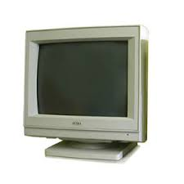

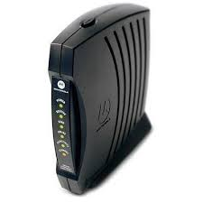
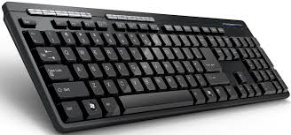
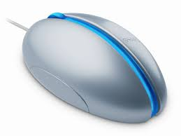

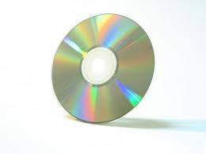
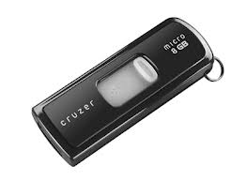
Kompjuter/kompjutor
modem
monitor
folder
Tastatura/tipkovnica
miš
USB
kursor
CD (ce-de)

Slide 3




Šta/što radimo sa kompjuterom/ kompjutorom?
Ulogovati se
na internet
To log on
Upaliti -to turn on
Ugasiti -to turn off
kliknuti mišem
kucati na kompjuteru/kompjutoru

Slide 4


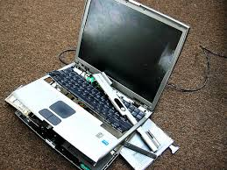
Kompjuter/kompjutor ne radi :(
Blokirati se
resetovati
Kompjuter/kompjutor ne radi.

Slide 5
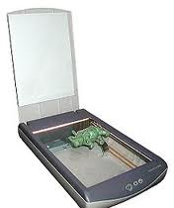
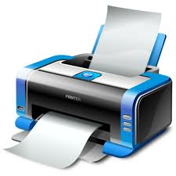
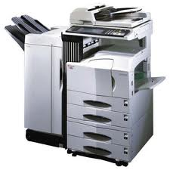
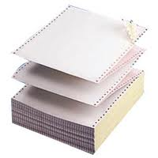
Šta/što još imamo u kancelariji/ uredu?
Štampač/pisač,tiskač(C)
Štampati/tiskati to print
skener
skenirati
Fotokopir mašina
fotokopirati
Papir za kopiranje

Slide 6
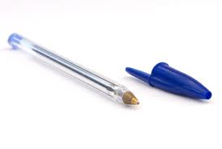

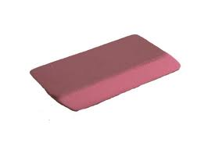
Čime pišemo?
Hemijskom/kemijskom olovkom
olovkom
Brišemo gumicom

Slide 7
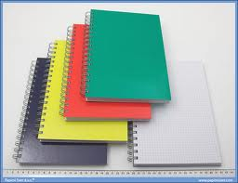
Gde/gdje pišemo?
U svesci/u teci

Slide 8

Na čemu kucamo?
Tastatura (S,B)/tipkovnica (C)-keyboard
Taster (S,B)/tipka (C) key
Kucati na tastaturi/tipkovnici (to type on the keyboard)

Slide 9
Computer related vocab
Surfovati na internetu
Downloadovati fajl
Posetiti/posjetiti website (visit a website)
Tvitovati -to tweet
Četovati /chatovati-to chat on the computer
Fejs/fejsbuk/facebook stranica-Facebook page
Mejl, email –email
Poslati mejl/email-to send e-mail
Dobiti mejl-to get e-mail

Slide 10
Vežba/ vježba
Using the new vocab ask your partner what do they have regarding office material? What is their favorite piece of office equipment? Ask them which computer parts are not working properly? Do they like to write or do they type? What they do when spending free time on the computer?
Write down the answers.

